Slide 1

GENERAL STUDIES (GST211)
LECTURE NOTES
PRESENTED
TO
LEVEL 200 B.Sc. COMPUTER AND B.Sc. ZOOLOGY AND MEDICAL STUDENTS
FIRST SEMESTER,2015/2016

Slide 2
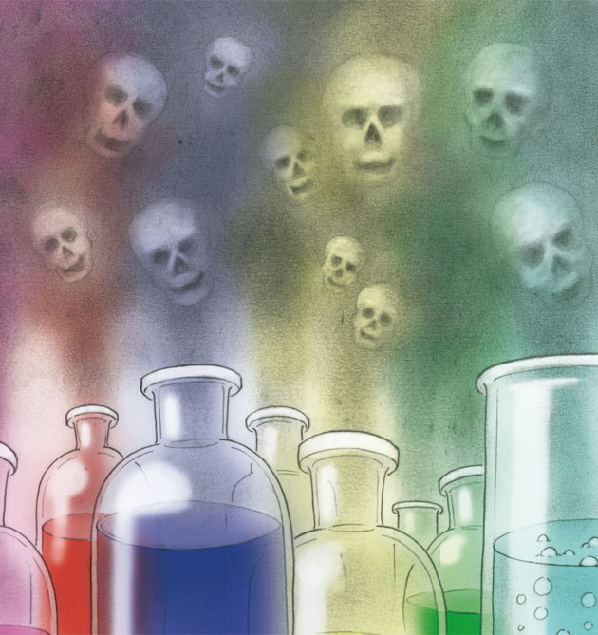
CHEMICAL HAZARDS PRESENTED
BY
MUNIR GARBA

Slide 3
INTRODUCTION
Human beings live with numerous hazards that threaten them.
Some hazards are related to human inventions,
Some to biological matters.
And others have to do with the type of work or activities human beings engage themselves in.

Slide 4
What is Hazard?
A hazard is anything in the workplace that has the potential to harm people.
Hazards can include objects in the workplace, such as machinery, biological agents or dangerous chemicals.
A hazardous situation that has come to pass is called an incident.
Hazard and possibility interact together to create risk.

Slide 5
Types of Hazards
Hazards are generally classified as one of four types, namely:
Physical,
Biological,
Ergonomic and,
Chemical.

Slide 6
Physical hazards
Are the most common and will be present in most workplaces at one time or another.
They include unsafe conditions that can cause injury, illness and death.
Examples include:
Unguarded machinery and moving machinery parts; constant loud noise;

Slide 7
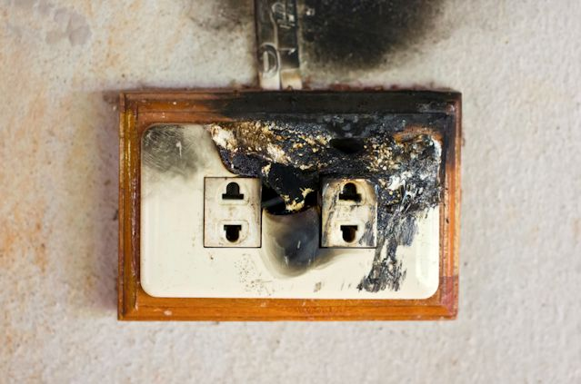

Electrical Hazards

Slide 8



Working from Heights (including ladders, Scaffolds, roofs, or any raised work area)

Slide 9
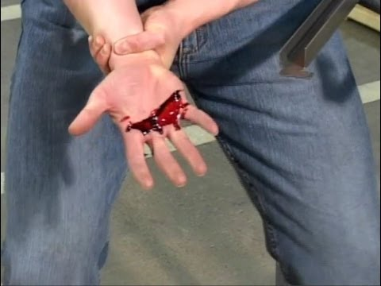
Unguarded Machinery and moving machinery parts

Slide 10
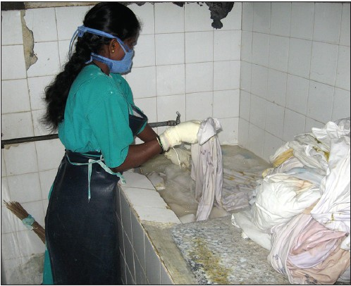
Biological hazards
Come from working with animals, people or infectious plant materials.
Work in day care, hospitals, hotel laundry and room cleaning, laboratories, veterinary offices and nursing homes may expose individual to biological hazards.

Slide 11
Biological hazards
The types of things individual may be exposed to include:
Blood or other body fluids,
Fungi, bacteria,
Viruses, plants,
Insect bites,
Animal and bird droppings.

Slide 12
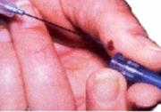
BIOLOGICAL HARZARDS

Slide 13
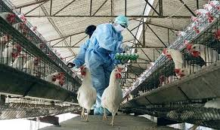
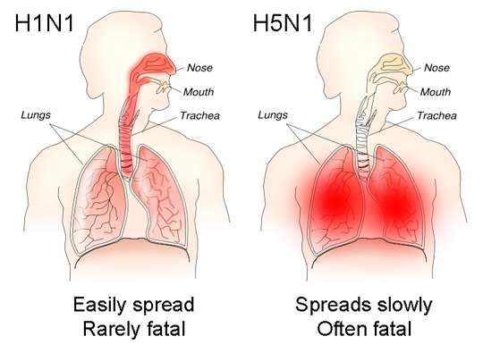
BIOLOGICAL HARZARDS

Slide 14
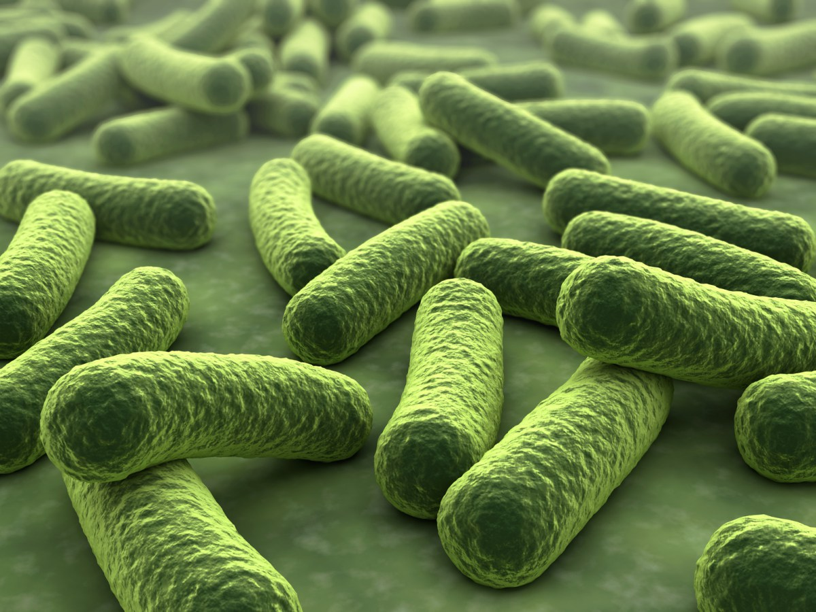
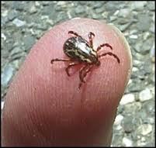
BIOLOGICAL HARZARDS

Slide 15
Ergonomic hazards
Ergonomic hazards occur when the type of work, body position and working conditions put strain on your body.
Short-term exposure may result in "sore muscles" the next day or in the days following exposure, but long term exposure can result in serious long-term injuries.
Ergonomic hazards include poor lighting, improperly adjusted workstations and chairs, frequent lifting, poor posture, awkward movements (especially if they are repetitive), having to use too much force (especially if you have to do it frequently).

Slide 16
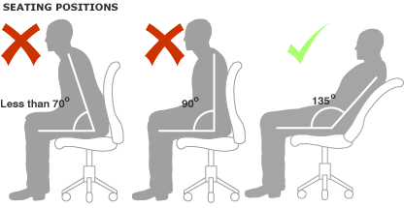
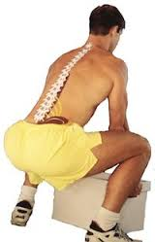
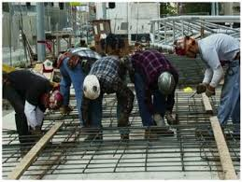
ERGONOMICS HAZARDS

Slide 17



Slide 18
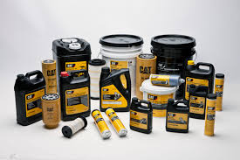
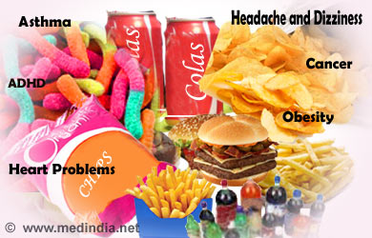
HUMAN EXPOSURE TO CHEMICALS

Slide 19

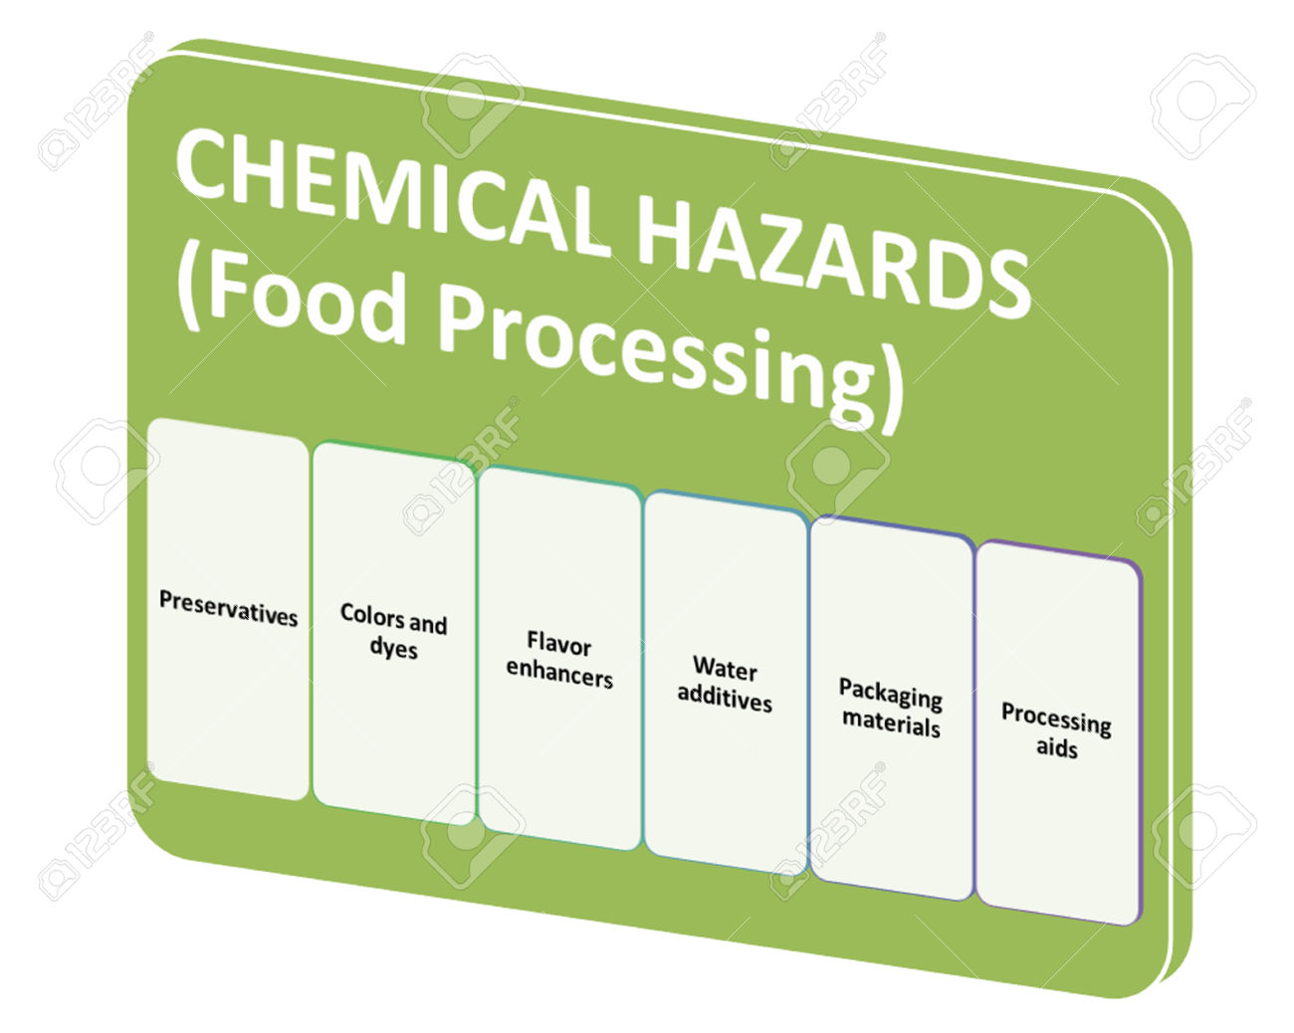
HUMAN EXPOSURE TO CHEMICALS
Chemicals are part of everyone's life.
5-7million known
400millions tons

Slide 20
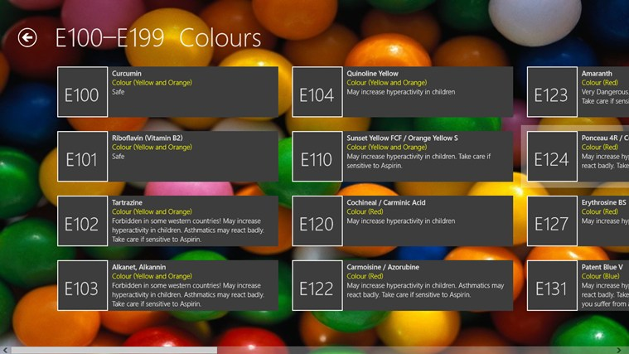
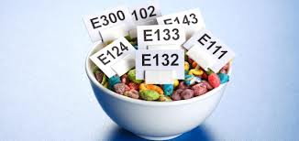
CHEMICALS AS ADDITIVES
Each additive is assigned unique number, termed as "E numbers", which is used in Europe for all approved additives.
E100-199 Colours
E 200-297 Preservatives
E 300-385 Acidity Regulators, Anti-Oxidants, Mineral Salts
E 400-495 Vegetable Gums, Thickeners, Emulsifiers, Stabilizers
E 500-586 Mineral Salts, Anti-Caking Agents
E 620-641 Flavor Enhancers
E 900-1521 Thickeners, Vegetable Gums, Humectants, Artificial
Sweeteners

Slide 21


Slide 22
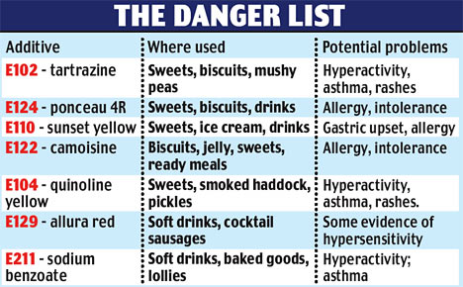

Slide 23
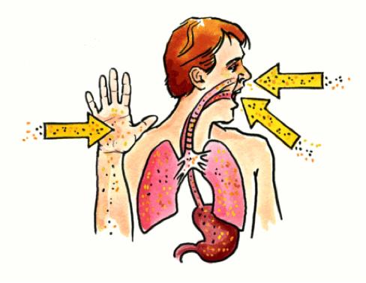
HOW TOXIC CHEMICALS ENTER THE BODY

Slide 24
Physiological Classification of Toxic Chemicals and their Effects
Irritants - refers to some sort of aggravation of whatever tissue the material comes in contact with. e.g. ammonia, nitrogen dioxide
Asphyxiants - exert their effects through a depletion of oxygen to the tissues e.g.
simple asphyxiants - carbon dioxide, nitrogen, methane, hydrogen
chemical asphyxiants - carbon monoxide, hydrogen cyanide, hydrogen sulphide.

Slide 25
Physiological Classification of Toxic Chemicals and their Effects
Narcotics or Anaesthetics - the main toxic action is the depressant effect upon the Central Nervous System. e.g. - many organics, chloroform, xylene.
Systemic Poisons - the main toxic action includes the production of internal damage e.g. hepatotoxic agents - toxic effects produce liver damage. e.g. carbon tetrachloride.
Nephrotoxic agents - toxic effects produce kidney damage e.g. some halogenated hydrocarbons

Slide 26
Physiological Classification of Toxic Chemicals and their Effects
Carcinogens - agents/compounds that will induce cancer in humans. e.g. benzene, arsenic, inorganic salts of chromium, nickel, beryllium. Ethidium Bromide.
Mutagens - agents that affect the cells of the exposed people in such a way that it may cause cancer in the exposed individual or an undesirable mutation to occur in some later generation. e.g. variety of chemical agents that alter the genetic message.

Slide 27
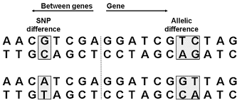
Physiological Classification of Toxic Chemicals and their Effects

Slide 28
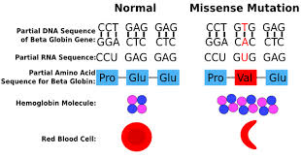
Physiological Classification of Toxic Chemicals and their Effects

Slide 29
Physiological Classification of Toxic Chemicals and their Effects
Teratogens - Agents or compounds that a pregnant woman takes into her body that generate defects in the fetus e.g. Thalidomide, possibly steroids. 13, cis-retinoic acid Isotretinoin.

Slide 30
Physiological Classification of Toxic Chemicals and their Effects
Thoraco-omphalopagus female conjoined twins(Females)

Slide 31
Factors that Determine the Type of Toxic Effect of a Chemical
There are a number of factors that determine the type of toxic effect a chemical can have on human beings. These factors include:
The chemical composition of the hazardous substance (certain substances are more harmful than others because of their chemical structure);
The physical form of the chemical (dust, vapour, liquid, etc.);

Slide 32
Factors that Determine the Type of Toxic Effect of a Chemical
3.The route of entry by which the chemical gets into the body (chemicals have different routes of entry.
4.The particular tissues and organs in which the chemical collects or localizes;
5.The frequency, concentration, and length of exposure
6The worker's individual response to the chemical, which can vary a great deal from person to person

Slide 33

The Material Safety Data Sheet (MSDS)
The material safety data sheet (MSDS) is a technical bulletin providing detailed hazard and precautionary information about a chemical.

Slide 34
The Material Safety Data Sheet (MSDS)
The MSDS provides:
Product information
Fire and explosion precautions
Toxicology
Health effects
Recommended personal protective equipment (PPE)
Storage recommendations
Leaks and spills—recommended actions
Waste disposal recommendations
First aid

Slide 35

Chemical Hazards Symbols and their Definitions
Flammable – A substance that will burn if exposed to an open flame.

Slide 36

Chemical Hazards Symbols and their Definitions
Explosive – A substance that may explode if exposed to heat or flame.

Slide 37

Chemical Hazards Symbols and their Definitions
Toxic/Poison – A substance that can lead to death if inhaled, ingested, or absorbed by the skin.

Slide 38

Chemical Hazards Symbols and their Definitions
Environmental - A substances that are harmful to the environment. They must be disposed of properly, not washed down the drain

Slide 39

Chemical Hazards Symbols and their Definitions
Irritant - A substance that causes inflammation upon contact with skin or mucous membranes

Slide 40
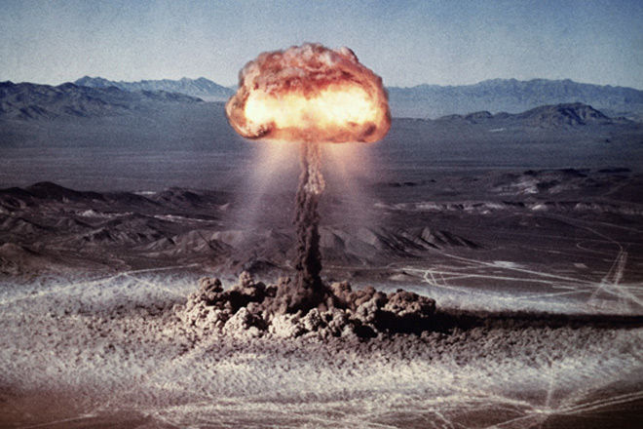
RADIOCHEMICAL HAZARDS

Slide 41
RADIOCHEMICAL HAZARD
What is Radioactivity?
Radioactivity is the spontaneous emission of radiation, and radiation is a way in which energy moves from one place to another.
Although radiation, if properly harnessed, is useful to human beings (in medicine, communication, electricity, etc.)
it is also very dangerous to all living things.
Radioactivity occurs when unstable nuclei of atoms decay and emit particles. These particles may have high energy and can have bad effects on living tissue.
Radiations are of two types, ionizing and non-ionizing.

Slide 42
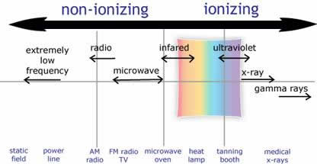
Types of Radiation
Radiations are of two types:
Non-ionizing Radiation
Ionizing Radiation

Slide 43
IONIZATION RADIATION
Despite the harmful effect of ionizing radiations we take advantage of its properties to:
Generate electric power
To kill cancer cells
And in many manufacturing processes

Slide 44
Radiation sources
Natural radiation comes from many sources including more than 60 naturally-occurring radioactive materials found in soil, water and air.
Man-made sources of radiation pollution are:

Slide 45
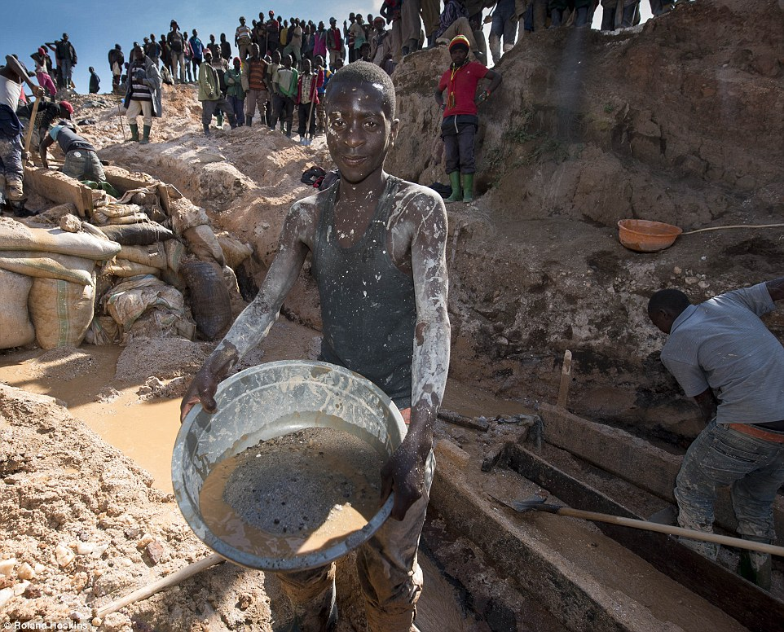
Mining and Refining Radioactive Metals such as Uranium, Plutonium, Thorium etc.

Slide 46
Production and explosion of nuclear weapons

Slide 47
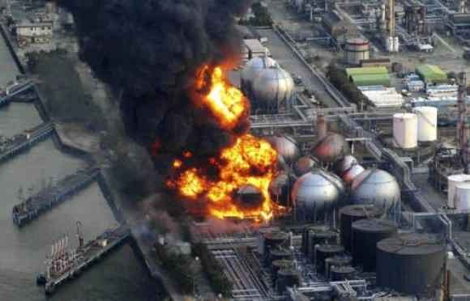
Production and explosion of nuclear power plants and fuels

Slide 48
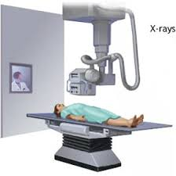
Medical Uses :Diagnosis or treatment of Cancer

Slide 49
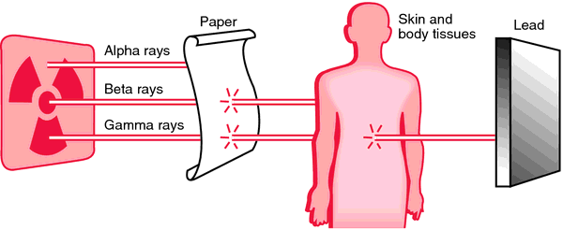
Types of Radioactive Decay
α DECAY
β DECAY
γ DECAY

Slide 50
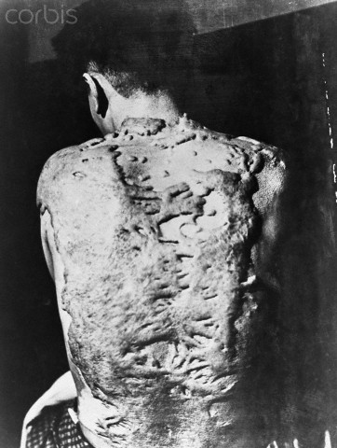
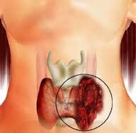
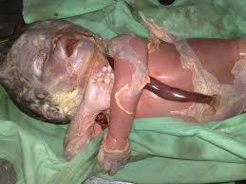
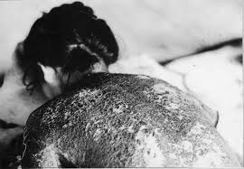
Effects of Radiation on Humans
Radiation occurs when unstable nuclei of atoms decay and release particles.
When these particles touch various organic materials, such as tissue, damage may occur. Radiation can causes:

Slide 51
The unit used to measure radiation dosage is the rem, which stands for roentgen equivalent in man (rem).
It represents the amount of radiation needed to produce a particular amount of damage to living tissue.
The total dose of rems determines how much harm a person suffers.

Slide 52
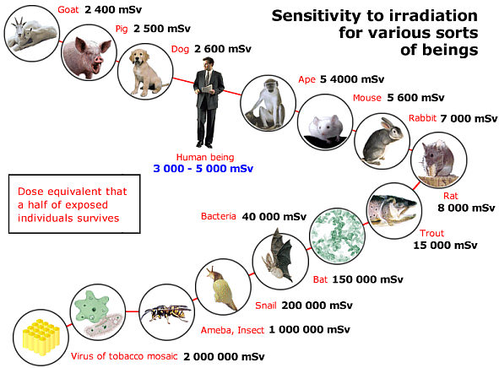
1rem=0.01 sv, 1rem= 0.055%

Slide 53
A dose of just 25 rems causes some detectable changes in blood,
Doses to near 100 rems usually have no immediate harmful effects.
Doses above 100 rems cause the first signs of radiation sickness including:
Nausea
Vomiting
Headache and
some loss of white blood cells

Slide 54
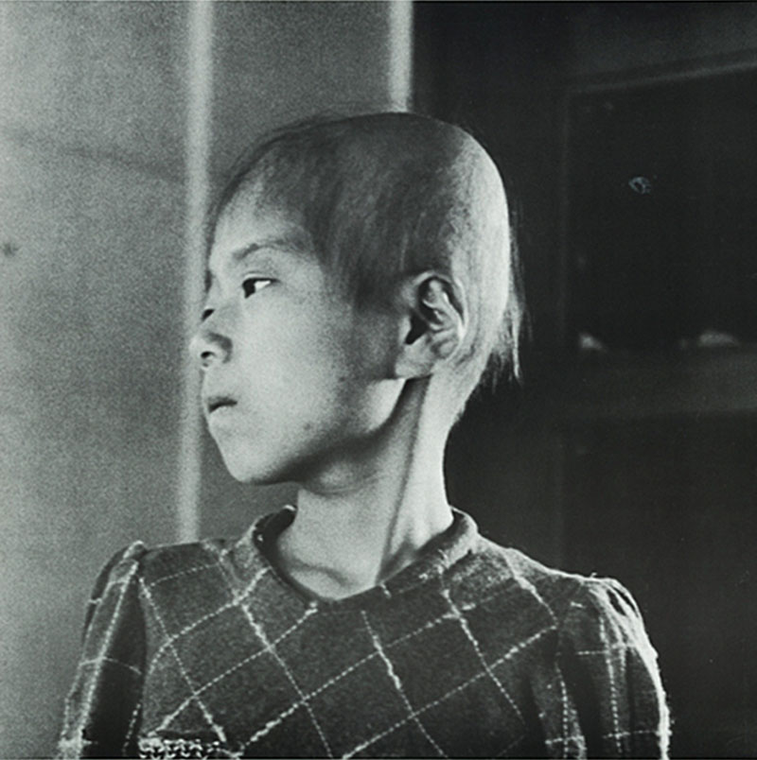
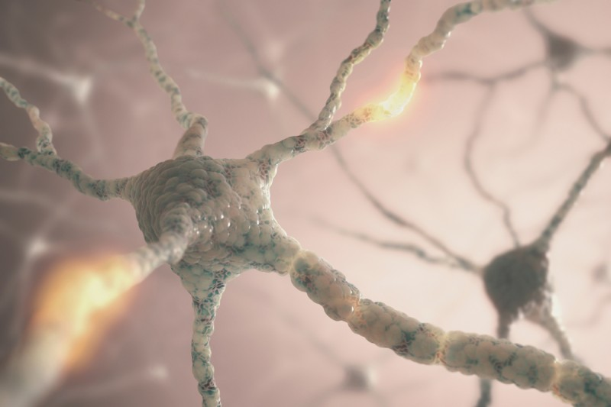
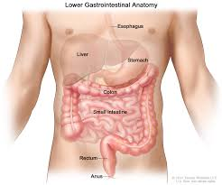
Doses of 300 rems or more causes

Slide 55
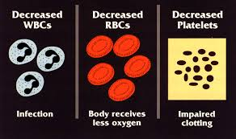
Doses of 300 rems or more causes

Slide 56
Half of all people exposed to 450 rems die
Doses of 800 rems or more are always fatal
No treatment to radiation
2-14 days

Slide 57
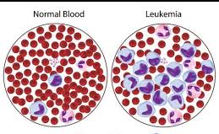
Radiation Survivors

Slide 58
Radiation Survivors

Slide 59
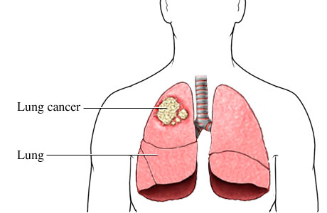
Radiation Survivors

Slide 60
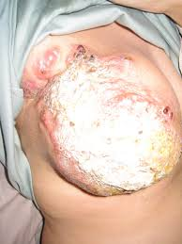
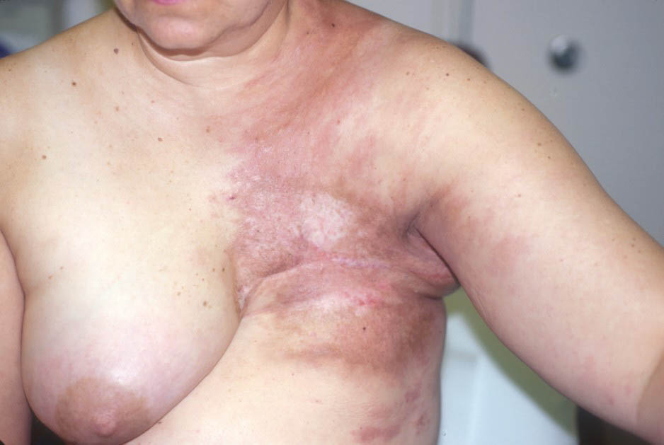
Radiation Survivors

Slide 61
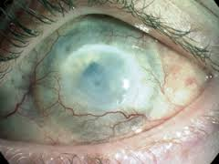
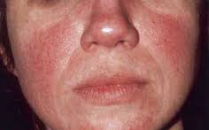
Effects of Types of Radiation
UV Rays
Ultra violet rays are short waves having wavelength 100-300 nm and high energy.
UV Rays 260nm

Slide 62
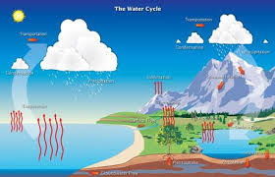
How nuclear waste enters the body

Slide 63
How nuclear waste enters the body
Radiation can also be in the air and can get deposited on people, plants, animals and soil.
People can inhale or ingest radionuclides in air, drinking water or food

Slide 64
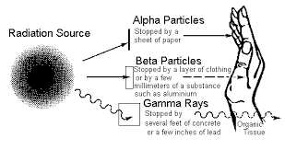
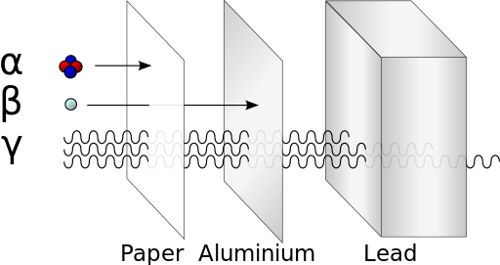
Reducing the effects of ionization radiation on the body
Use of radiation shielding materials. They include lead lined doors, leaded x-ray safety glass, leaded glass, lead lined door frames, lead lined view window frames, and many other lead shielding and industrial lead products

Slide 65
Reducing the effects of ionization radiation on the body
Reducing the time of an exposure reduces the effective dose proportionally.
Proper disposal is key to protecting the public's health and safety and the quality of the environment.
Government regulation of the use of radioactive materials

Slide 66


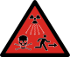
Radiation Hazards Symbols and their Definition
Non-Ionization Ionization Radiation Radiation Danger

Slide 67
Thank you
for
Listening

Slide 68
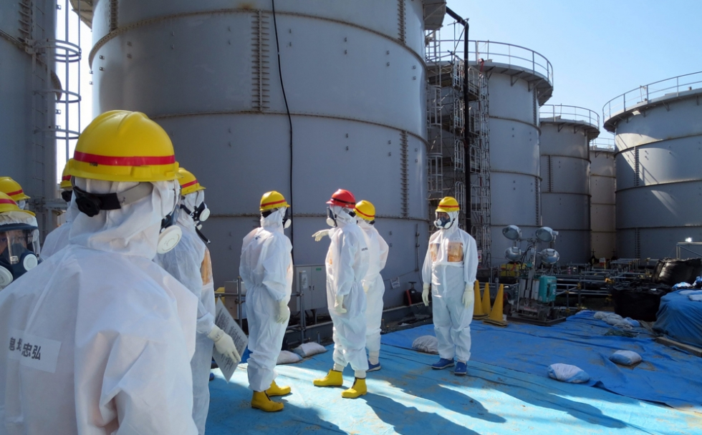

Slide 69
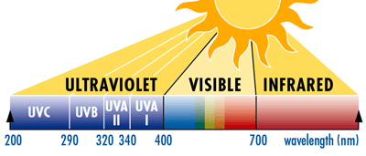

Slide 70
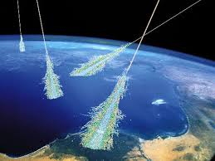

Slide 71
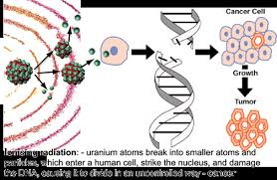

Slide 74


Slide 75


Slide 76


Slide 77


Slide 78


Slide 79



Aftermath of Atomic Bomb in Hiroshima

Slide 80

Aftermath of Atomic Bomb in Nagasaki

Slide 81
Aftermath of Atomic Bomb in Nagasaki
On August 9, 1945, during World War II, a United States Army Air Force plane released an atomic bomb on the Japanese city of Nagasaki. The blast destroyed about a third of the city and left an estimated 40,000 people dead or missing

Slide 82
An aerial photograph reveals the devastation inflicted on Hiroshima, Japan, by an atomic bomb that was dropped on the city on August 6, 1945. Seventy thousand people were killed instantly, and 68 percent of the city was destroyed in the blast. The death toll eventually climbed to 200,000 due to radiation

Slide 83


